Slide 1




MONITOR AND MAINTAIN A BUSINESS COMPUTER SYSTEM
D1.HGE.CL7.05 D1.HML.CL10.04 D1.HRM.CL9.13 D2.TRM.CL9.15
Notes:
Trainer welcomes students to class and introduces unit.

Slide 2
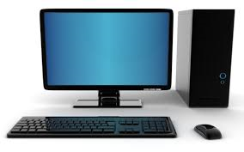
Subject elements
This unit comprises three elements:
Monitor effectiveness of computer equipment
Purchase hardware and software
Maintain computer equipment and systems
Notes:
Trainer advises this Unit comprises three Elements, as listed on the slide explaining:
• Each Element comprises a number of Performance Criteria which will be identified throughout the class and explained in detail
• Trainees can obtain more detail from their Trainee Manual
• At times the course presents advice and information about various protocols but where their workplace requirements differ to what is presented, the workplace practices and standards, as well as policies and procedures must be observed.

Slide 3

Assessment
Assessment for this unit may include:
Oral questions
Written questions
Work projects
Workplace observation of practical skills
Practical exercises
Formal report from supervisor
Notes:
Trainer advises that assessment for this Unit may take several forms all of which are aimed at verifying they have achieved competency for the Unit as required.
Trainer indicates the methods of assessment that will be applied to them for this Unit.

Slide 4
Element 1:
Monitor effectiveness of computer equipment
Notes:
Introduce topic.
Class Activity – General Discussion
Ask general questions:
What does effectiveness mean?
What do you want to monitor?
How can you monitor it?

Slide 5
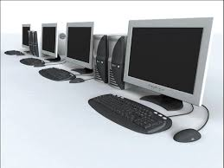
Monitor effectiveness of computer equipment
Performance Criteria for this Element are:
Monitor and evaluate the effectiveness of computer equipment to ensure it meets enterprise needs through ongoing consultation with users
Monitor effectiveness through assessment of productivity and efficiency
Establish and implement procedures for identifying and resolving performance problems including use of specialised assistance
Identify computer training needs and provide training opportunities
Notes:
Trainer identifies the Performance Criteria for this Element, as listed on the slide.

Slide 6
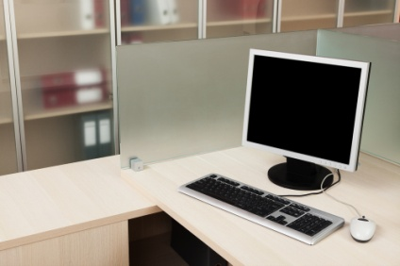
Business computer system
Importance of a business computer system
A business computer system is one of the fundamental tools that tourism personnel use to provide services to customers.
What is included in a computer system?
What is a computer system used for?
Why is it an important business tool?
Notes:
Discussion
Discuss the questions in the slide.

Slide 7
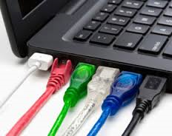
Business computer system
Key assets of a business computer system
Internet service provider
Modem
Router
Network card
Servers
Wired or Ethernet networks
Wireless networks
Local area network (LAN)
Notes:
Discussion
Briefly discuss each element as they will be explained in more detail in Section 2.1.

Slide 8

Business computer system
Key assets of a business computer system
Network security
Personal Computers (PC's)
Monitors
Keyboards
Mouse
Scanners
Printers
Multifunction devices (MFDs)
Back-up systems
Notes:
Discussion
Briefly discuss each element as they will be explained in more detail in Section 2.1

Slide 9

Business computer system
Key expectations of a business computer system
Capable of performing the tasks you need to run a tourism organisation
Affordable
Well built
Reliable
Simple to use and maintain
Easy to upgrade
COMPLETE ACTIVITY 1
Notes:
Discussion & Complete Activity
What other expectations would you have?
Rely on past experiences when buying personal computers or working in an office environment.
Complete Activity 1

Slide 10

Identify computer system needs
Understand business strategies and requirements
The use and purchase of computer assets are important activities in any business.
Before an organisation purchases an expensive computer system it is important to understand:
What are the strategies of the organisation going forward?
What are the current and future business computer requirements?
Notes:
Discussion
How can you find out about future strategies and computer requirements?
What factors need to be taken into consideration?

Slide 11

Identify computer system needs
Develop business computer system research questions
When identifying the needs of a computer system is it wise to create a list of questions that will guide the research process.
What research questions would you develop?
COMPLETE ACTIVITIES 2&3
Notes:
Discussion & Complete Activities
Discuss the question in the slide.
Refer to TM Page 14 for suggestions.
Complete Activities 2&3

Slide 12
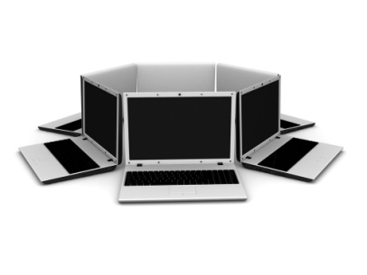
Identify computer system needs
Involving stakeholders in determining business computer system asset needs
For managers it is important to identify:
Who the relevant stakeholders may be
Why their input is important
How such contributions may be obtained
Notes:
Discussion
Which stakeholders may be involved?

Slide 13

Identify computer system needs
Involving stakeholders in determining business computer system asset needs
Owners of the business
Managers
Supervisors
Staff, teams and workgroups
Customers
Suppliers
IT consultants
Notes:
Discussion
Why are each of these stakeholders selected?
What input can they provide?

Slide 14

Identify computer system needs
Involving stakeholders in determining business computer system asset needs
Their input can help clarify:
The structure of the business computer system to meet the desired technical needs
Identification of all pieces of hardware and software assets required
Quantities to be obtained
Timelines that apply to acquisition
Brands, models and types to be considered
Restrictions that apply
Notes:
Discussion
Discus the importance of these types of input.

Slide 15

Identify computer system needs
Involving stakeholders in determining business computer system asset needs
Their input can help clarify:
The needs of users
Customer needs
Introduction and installation
Training required
Financing arrangements
COMPLETE ACTIVITY 4
Notes:
Discussion & Complete Activity
Discus the importance of these types of input
Complete Activity 4

Slide 16

Monitor effectiveness of current computer system
Importance of monitoring current computer system
Many assets purchased by a business, including computer system assets will need to have their performance monitored.
Monitoring performance allows more informed decisions to be made about:
Effectiveness of current asset items
Guide future purchasing decisions
Notes:
Discussion
How can you monitor?

Slide 17

Computer system asset management
Computer system asset management activities
Planning for assets
Creating or acquiring new assets
Accounting for assets and determining the actual cost of the services they provide
Operating and maintaining assets
Monitoring performance and condition of assets
Notes:
Discussion
Why are these activities important?
What tasks are associated with each of these activities?

Slide 18

Computer system asset management
Computer system asset management activities
Assessing refurbishment, renewal and replacement options
Disposing of assets that are no longer required
Auditing the way in which assets are managed and the asset management practices and procedures
Identifying and working to minimise life cycle costs of new assets
Notes:
Discussion
Why are these activities important?
What tasks are associated with each of these activities?

Slide 19

Computer system asset management
Aspects of computer system asset management
The performance of the asset is evaluated against the level of service provided to the customer.
This can generally be measured in terms of:
Reliability
Availability
Capacity
Meeting customer demands and needs
Notes:
Discussion
What would be measured and managed for each of these aspects?

Slide 20

Computer system asset management
Systems to monitor condition and performance of business computer system
Integration of reporting into day to day operating procedures
Regular management reports
Internal and external inspections and audits
Regular staff feedback
Analysis of maintenance costs over a period of time
COMPLETE ACTIVITY 5
Notes:
Discussion & Complete Activity
What other methods of measurement could be used?
Complete Activity 5

Slide 21
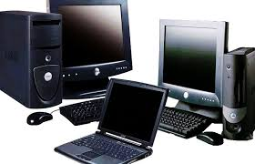
Element 2:
Purchase hardware and software
Notes:
Introduce topic.
Class Activity – General Discussion
Ask general questions:
What is hardware?
What is software?
What are examples of each?

Slide 22
Purchase hardware and software
Performance Criteria for this Element are:
Identify broad computer equipment hardware and software requirements accurately and research possible new approaches using appropriate information sources
Assess the feasibility of acquiring or upgrading hardware and software based on available information
Evaluate options against the needs of the enterprise, including advantages and limitations
Investigate user-friendliness, system support and training issues
Notes:
Trainer identifies the Performance Criteria for this Element, as listed on the slide.

Slide 23

Purchase hardware and software
Performance Criteria for this Element are:
Seek external specialist assistance as required
Make decisions on computer acquisitions in consultation with appropriate colleagues
Plan introduction of new computer systems to take account of impacts on colleagues and customers
Ensure staff are adequately trained in using new systems
Monitor new systems for efficiency and take action accordingly
Notes:
Trainer identifies the Performance Criteria for this Element, as listed on the slide.

Slide 24
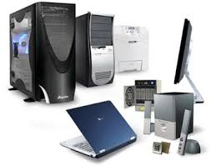
Understand computer system assets
Understand types of computer system assets
One of the most important tasks in deciding on the purchase of a business computer system is to understand the different types of assets that make up a system.
What are examples of:
Hardware
Software
Notes:
Discussion
Discuss the questions in the slide.
This is a refresher from assets mentioned in Section 1.1.

Slide 25

Understand computer system assets
Sources of computer system information
Computer magazines and journals
Trade fairs
Computer software designers
Computer hardware manufacturers
Retail outlets
Internet
Industry associations
Seminars, workshops and training sessions
Internal/external clients
Notes:
Discussion
What are examples of these sources in your local area?

Slide 26

Setting up a computer system/network
Setting up a computer system/network
Setting up a computer network is a good way to get more out of your system and its assets.
Networking allows personnel to manage all of the operations of a small business including communication, data transfer, and storage.
What is the difference between a computer system and a network?
What assets are required to set up both?
Notes:
Discussion
Discuss the questions in the slide.

Slide 27

Internet connectivity
Internet service provider (ISP)
Common types of internet service:
Dial-up
DSL
3G and 4G
Notes:
Discussion
Discuss the differences between these types of internet services

Slide 28

Internet connectivity
Internet service provider (ISP)
Considerations when selecting an ISP include:
Speed
Price
Ease of installation
Service record
Technical support
Contract terms
Notes:
Discussion
What are the different options available for each of these points?

Slide 29
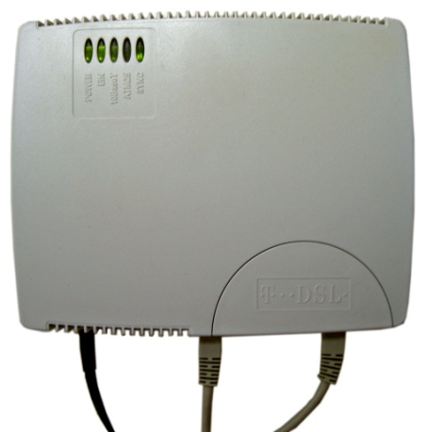
Internet connectivity
Modem
The primary piece of hardware needed to connect to the internet is a modem.
The type of Internet access selected will determine the type of modem an organisation will need including:
Dial-up access uses a telephone modem
DSL service uses a DSL modem
Notes:
Discussion
What are different options available for this computer asset?
What is the difference between the options?

Slide 30
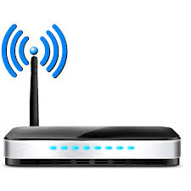
Internet connectivity
Router
A router is a hardware device that allows a tourism establishment to connect several computers and other devices to a single Internet connection
Many modems now include a built-in router
Notes:
Discussion
What are different options available for this computer asset?
What is the difference between the options?

Slide 31
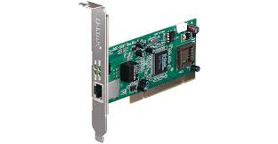
Internet connectivity
Network card
A network card is a piece of hardware that allows computers to communicate over a computer network
The network card will have an Ethernet port, a wireless connection, or both
Notes:
Discussion
What are different options available for this computer asset?
What is the difference between the options?

Slide 32
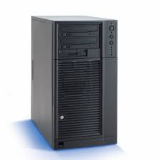
Internet connectivity
Servers
A computer that has been optimised to provide services to other computers over a network
Servers usually have powerful processors, lots of memory and large hard drives
Notes:
Discussion
What are different options available for this computer asset?
What is the difference between the options?

Slide 33

Wired and wireless networks
Wired and Wireless Networks
The first decision you will need to make about your new computer system network is whether you would like it to be wired or completely wireless.
In many cases both options are used:
Desktop - connected to the Internet with an Ethernet cable
Laptop computer - connected via a wireless router
Notes:
Discussion
What are the advantages of both wired and non-wired set-ups?

Slide 34
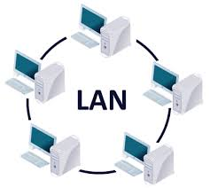
Networking
Local area network (LAN)
A local area network (LAN) supplies networking capability to a group of computers in close proximity to each other
A LAN is useful for sharing resources like files, printers, games or other applications
Notes:
Discussion
What is the benefit of establishing a LAN?
How can you do it?

Slide 35

Networking
Local area network (LAN)
Each of these local networks may:
Stand alone disconnected from any other network
May connect to other LANs
Connected to a WAN (wide area networks) - which reach across cities and other countries
Notes:
Discussion
What is the benefit of establishing a LAN?
How can you do it?

Slide 36
Networking
Network Setup
The next step in how to set up a small business computer network is deciding whether to make it a peer-to-peer setup or a client-server one.
Both networks connect computers so that resources can be shared between them.
Peer-To-Peer Setup
Client-Server Setup
Notes:
Discussion
What is the difference between the two set ups?
Peer-To-Peer Setup
In a peer-to-peer setup, every computer acts as both the client and the server.
Client-Server Setup
In a client-server setup, multiple clients (computers) connect to a single, central server.

Slide 37
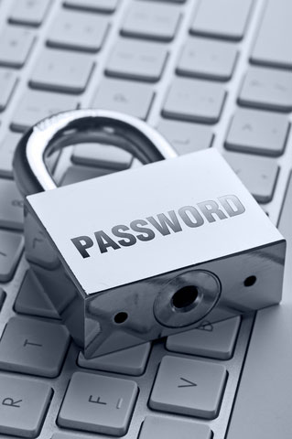
Networking
Setting up a secure network
Once you have decided upon the type of network, it is important that it is protected.
You can secure a network a number of ways, including through:
The router - through the use of security settings
The operating system
Wireless encryption protocol (WEP) uses passwords to encrypt the network traffic.
Notes:
Discussion
Describe the concept of WEP.

Slide 38
Personal computers
Personal Computers (PC's)
Personal computers are an essential part of any business computer system.
The personal computer (PC) defines a computer designed for general use by a single person.
The two main operating systems used for PC's include:
Windows
Mac
Notes:
Discussion
What are different options available for this computer asset?
What is the difference between the options?

Slide 39

Personal computers
Types of personal computers
Desktops
Laptops
Netbooks
Tablet computers
Thin clients
Notes:
Discussion
What are the differences between these PC’s?

Slide 40
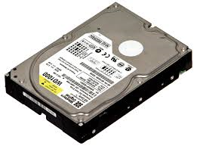
Personal computers
Key features of a personal computer
Processor
Graphics card
Hard disk
Operating system
RAM
Notes:
Discussion
Explain the different features including their purpose and functions

Slide 41
Monitors
Types of computer monitors
LCD (liquid crystal display) monitors
LED (light-emitting diodes) monitors
Considerations when purchasing monitors
Size
Resolution
Notes:
Discussion
What are different options available for this computer asset?
What is the difference between the options?

Slide 42

Keyboards
Keyboards
Keyboards are available in a wide array of options, with some suitable for use only with nominated or 'supported' software.
Wireless capacity
Ergonomic design
Customisable hot keys
Single touch pad
Keyboard scrolling wheel
USB ports
Notes:
Discussion
What are different options available for this computer asset?
What is the difference between the options?

Slide 43

Mouse
Mouse
Wireless option
Extra buttons
Wheel scrolling for accelerated page scrolling
Left-hand and right-hand design
Notes:
Discussion
What are different options available for this computer asset?
What is the difference between the options?

Slide 44
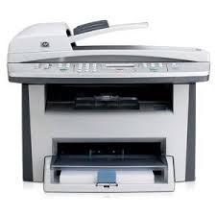
Multifunction devices (MFDs)
Multifunction devices (MFDs)
MFDs are pieces of equipment where a number of items are combined into the one piece of equipment.
The common functions are performed using MFD's include:
Print
Copy
Scan
Fax
Notes:
Discussion
What are different options available for this computer asset?
What is the difference between the options?

Slide 45
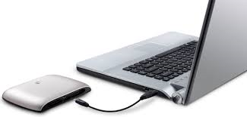
Computer back-up systems
Back up system considerations
When choosing a backup system there are a number of considerations including:
Amount of data you have
Amount of computers
Amount of hands-on involvement required
Backup speed
Sensitivity of your data
Your level of computer expertise
Physical size of the drive
Notes:
Discussion
What are different options available for this computer asset?
What is the difference between the options?

Slide 46
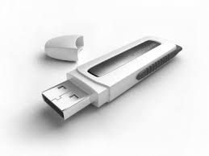
Computer back-up systems
Types of back-up drives
Backup solutions include:
Internal drives
External drives
Network drives
Online services
Thumb drives
CD or DVD backups
COMPLETE ACTIVITY 6
Notes:
Discussion & Complete Activity
What is the difference between these back up systems?
Complete Activity 6

Slide 47

Software
Definition of software
General term for the various kinds of programs used to operate computers and related devices
What are examples of software used in business?
Notes:
Discussion
Discuss the question in the slide.

Slide 48

Software
Software functions
Popular software functions include:
Word processing
Spreadsheets
Databases
Communication
Presentation
Sharing
Internet browsers
Accounting software
Groupware and collaboration
Notes:
Discussion
Describe the Microsoft Office software packages.
What other integrated packages exist?

Slide 49
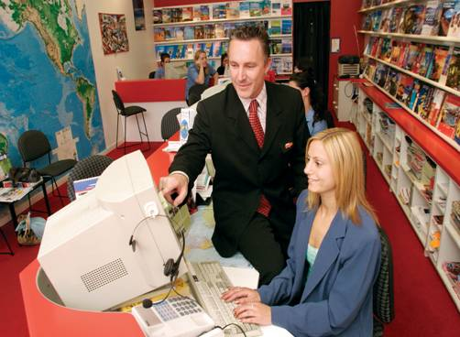
Tourism computer systems
Tourism systems
Commonly used industry‑wide systems used by travel organisations include:
Global distribution system (GDS)
Computerised or centralised reservations system (CRS)
Notes:
Discussion
What is the difference between these systems?

Slide 50

Tourism computer systems
Global Distribution System (GDS)
The Global Distribution System (GDS) is an e-commerce tool introduced by airlines to facilitate the booking of flights.
There are four major Global Distribution Systems:
Amadeus
Galileo
Sabre
Worldspan
Notes:
Discussion
Discuss the use and benefits of a GDS.

Slide 51

Tourism computer systems
Computerised reservation systems (CRS)
There are many computerised reservation systems (CRS) in use today and while they all provide similar functions, menus, sub-menus, options, reports, statistics and accounting facilities the individual programs are all unique.
What are examples of CRS’s?
What is their purpose?
How do they benefit a tourism organisation?
COMPLETE ACTIVITY 7
Notes:
Discussion & Complete Activity
Discuss the questions in the slide.
Complete Activity 7

Slide 52

Assess computer system purchase options
Conducting research into suitable computer system options
Now that we have identified the types of computer assets and possible quantities required it is now time to undertake procurement
As part of the procurement process a feasibility study will be conducted to identify, research, evaluate and select the best computer assets to meet your requirements
Notes:
Discussion
What is procurement?
What is feasibility?

Slide 53
Assess computer system purchase options
Procurement
Procurement is the process of sourcing and purchasing computer system assets.
What are considerations when purchasing computer system assets?
Notes:
Discussion
Discuss the question in the slide.
Refer to TM page 49 for suggestions.

Slide 54

Assess computer system purchase options
Computer system asset purchasing considerations
Cost
Availability
Warranties and after-sales service
Lead times
Service centre locations
Interruptions related to servicing
Parts and replacement policies
Notes:
Discussion
Discuss these considerations

Slide 55
Assess computer system purchase options
Computer system asset purchasing considerations
Product quality
Reliability, suitability of use and durability
Continuity of supply
Terms of trade
Rebates and discounts
Staff training provided by suppliers
Incentives to purchase
Notes:
Discussion
Discuss these considerations
What other considerations would you have?

Slide 56

Assess computer system purchase options
Definition of feasibility
Feasibility is based around objectively and rationally researching and understanding the strengths and weaknesses of various options to make an informed and calculated decision.
What are feasibility activities?
Notes:
Discussion
Discuss the question in the slide.

Slide 57

Assess computer system purchase options
Feasibility activities
Assess the feasibility may relate to:
Identify the best method of acquiring required components
Identifying advantages and disadvantages of each acquisition method
Researching the different options that exist for the desired computer asset
Assessing costs against available budget
Notes:
Discussion
What tasks are associated with these activities?

Slide 58

Assess computer system purchase options
Methods to acquire computer system assets
Off-the-shelf products
Custom built
Used equipment
COMPLETE ACTIVITIES 8&9
Notes:
Discussion & Complete Activities
What are the advantages and advantages of each method?
Complete Activities 8&9

Slide 59

Assess computer system purchase options
Conduct research into required computer systems assets
The whole purpose of the this process is to gather current, accurate and relevant data used for:
Identifying the most suitable asset
Estimating costs for the asset
Understanding support services and warranties etc
Notes:
Discussion
What are the activities associated with conducting research?

Slide 60

Assess computer system purchase options
The tender process
Collect tender information
Evaluation of tender information
Rating essential and negotiable requirements
Identify criteria used to evaluate delivery response times by supplier
COMPLETE ACTIVITIES 10&11
Notes:
Discussion & Complete Activities
What tasks are associated with each of these tender activities?
Refer to TM Pages 54&55
Complete Activities 10&11

Slide 61

Key purchasing priorities
Identify key non-finance purchasing priorities
Following are examples of key purchasing priorities that will guide the non-financial decision making process.
Ease of use of the asset
Ease of integration into the existing workplace
Reliability of the item
Safety
Compliance
Notes:
Discussion
Discuss these priorities

Slide 62

Key purchasing priorities
Identify key non-finance purchasing priorities
Asset achieves or exceeds the results/outcomes expected of it
Resale value
Enhanced service levels
Support services
Training requirements and training provided by suppliers
COMPLETE ACTIVITY 12
Notes:
Discussion & Complete Activity
Discuss these priorities
What other non-financial purchasing priorities would you have?
Complete Activity 12

Slide 63
Computer support services
Importance of computer hardware and software support services
Why are these services important?
What types of services and support are available?
Notes:
Discussion
Discuss the questions in the slide.

Slide 64

Computer support services
Types of support services
On-line help
Manuals and training booklets
Training
COMPLETE ACTIVITY 13
Notes:
Discussion & Complete Activity
Discuss the types of support services mentioned in the slide
What other support services are available in your region?
Complete Activity 13

Slide 65

Seek external specialist assistance
Importance of external assistance
Naturally the planning, design and implementation of computer systems is a complex initiative
No one manager will have the necessary skills and knowledge to undertake this exercise by themselves
They will require the assistance of various specialists for a variety of reasons
Notes:
Discussion
What options are available?
What assistance can they provide?

Slide 66
Seek external specialist assistance
Types of general assistance
Your accountant
Your auditor
Owners of the business
Managers
Supervisors
Staff, teams and workgroups
Customers
Suppliers
IT consultants
Notes:
Discussion
What assistance can the above people provide?

Slide 67
IT specialist services
Network design and installation
Initial strategic planning
Applications development
Systems integration
Expand and improving existing computer systems
Design and install all sizes of networks
Ensure connectivity
Make recommendations on all aspects of computing
IT upgrade, installation or migration
Notes:
Discussion
Discuss these specialist services.

Slide 68

IT specialist services
IT Consultancy
Remote, onsite and 24/7 services
Remote working away from the office with a virtual desktop
Mobile working for emails on the move
Email security, anti-virus, anti-SPAM solution
Secure offsite backup of data
Bespoke Software Application Development
Website and eBusiness design
Notes:
Discussion
Discuss these specialist services

Slide 69

IT specialist services
Software Application Development
Initial requirements definition
Architecture design
Application selection and integration
Development and deployment
Customisation and integration of third-party software
Design and development of content management systems for corporate intranets and extranets
Internationalisation and localisation of Web applications
COMPLETE ACTIVITY 14
Notes:
Discussion & Complete Activity
Discuss these specialist services
Complete Activity 14

Slide 70

Make computer acquisition decision
Consider budget requirements
Naturally the greatest influence in purchasing computer assets will be the budget
The computer assets that a business can obtain are often limited by the budget available for purchasing items
Management will determine the level of funding available for computer system assets and make an amount available through its budgets
COMPLETE ACTIVITY 15
Notes:
Discussion & Complete Activity
Why do budgets need to be considered?
How can you allocate budgets for computer systems?
Complete Activity 15

Slide 71
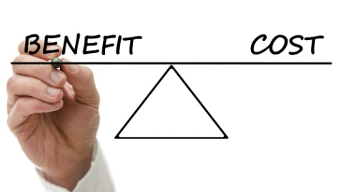
Cost–benefit analysis
Undertake a cost–benefit analysis
An accepted way of ensuring realistic computer asset expenditure is to undertake a cost–benefit analysis in relation to the asset that is to be purchased
What are possible costs?
What are possible benefits?
Notes:
Discussion
Discuss the questions in the slide.

Slide 72

Cost–benefit analysis
Costs
Purchase price
Opportunity cost
Cost of finance
Testing or compliance costs
Transportation costs
Site preparation costs
Notes:
Discussion
What are costs associated with each of these points?

Slide 73

Cost–benefit analysis
Costs
Installation costs
Make-ready costs
Tooling, parts and suppliers
Spare parts costs
Training costs
Cost of power and consumables
Notes:
Discussion
What are costs associated with each of these points?

Slide 74

Cost–benefit analysis
Costs
Service and maintenance costs
Insurance costs for the new item
Cost of adapting existing systems and procedures to accommodate the new purchase
Lost sales caused by interruption to normal business
Reduced levels of earnings while staff learn the new item
Depreciation
Notes:
Discussion
What are costs associated with each of these points?

Slide 75

Cost–benefit analysis
Benefits
Higher levels of earnings/revenue Reduced levels of unsatisfactory services
Energy savings
Labour savings
Savings on raw materials
Sale value of any equipment that is being disposed
Enhanced image or market positioning
COMPLETE ACTIVITY 16
Notes:
Discussion & Complete Activity
What other benefits exist?
Complete Activity 16

Slide 76

Methods of financing
Identify methods of financing
When purchasing computer system assets, it is important to identify the most efficient use of finances.
In summary, the different methods of financing include
Purchasing
Leasing
Hiring
COMPLETE ACTIVITY 17
Notes:
Discussion & Complete Activity
Discuss the differences, advantages, disadvantages of each financing method
Complete Activity 17

Slide 77
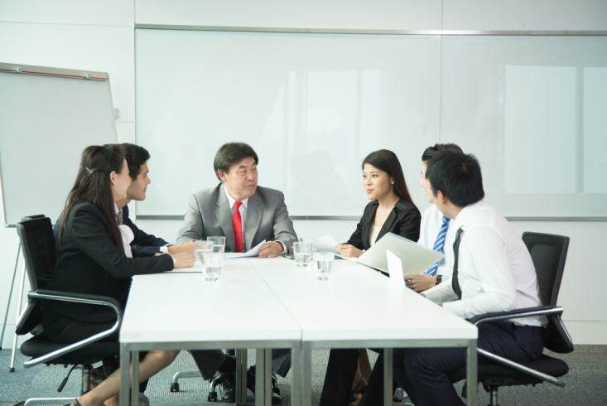
Making the final decision
Identify necessary prerequisites prior to purchasing assets
To know what the item is required to do
To know the businesses with whom your organisation will deal
Preferred method of acquisition for the business
The terms that your business wants applied to the purchase
Non-negotiable elements of any deal
Necessary authority to go ahead and make the purchase
COMPLETE ACTIVITY 18
Notes:
Discussion & Complete Activity
What other prerequisites would you have prior to purchasing assets?
Complete Activity 18

Slide 78
Implement new computer assets
Prepare for implementation
Now that all computer system purchasing decisions have been made, it is now time to prepare for its implementation.
Naturally the greater the degree of change to hardware and software will have a greater impact on staff, ranging from greater anxiety to lower productivity.
What tasks are associated with the implementation of computer system assets?
Notes:
Discussion
Discuss the questions in the slide.

Slide 79

Implement new computer assets
Implementation considerations
Identify all implementation actions to be taken
Allocation of responsibilities for action to nominated persons
Determination of accountability for actions taken
Timelines for completion of nominated actions
Compliance requirements
Occupational safety and health (OSH)
Notes:
Discussion
Discuss the actions associated with each of these points

Slide 80
Implement new computer assets
Implementation considerations
Arranging arrival and security of new computer assets
Timing of new system assets to be implemented
Saving information from old system assets
Removal, storage and sale of old computer assets
Arranging location and physical layout of new assets
Unpacking and installing new computer assets
Timing issues
Resources
Notes:
Discussion
Discuss the actions associated with each of these points

Slide 81

Implement new computer assets
Implementation considerations
Aligning new computer assets to existing structures, hardware and software systems
Integration with other aspects of the business
Adding information to new computer system assets
Changes to policies and procedures
Documentation & record keeping
Impact on organisational culture
Anticipation of problems
Training for staff
Notes:
Discussion
Discuss the actions associated with each of these points
What else needs to be considered?

Slide 82

Implement new computer assets
Communicate implementation actions
Reasoning or purpose behind the changes to the computer system
Identification of the key changes that are taking place
Identification of how the new computer system will benefit them
Start dates of implementation
Expected completion dates
How the implementation will be implemented
Notes:
Discussion
What information needs to be discussed under each of these points?

Slide 83

Implement new computer assets
Communicate implementation actions
Activities to be performed
Resources required to implement the plan
Work breakdown
Involvement of other staff
Roles and responsibilities of staff
Pre-change activities
Notes:
Discussion
What information needs to be discussed under each of these points?

Slide 84

Implement new computer assets
Communicate implementation actions
Timelines for implementation
Training activities that will take place
Support mechanisms
Expected standard of performance
Milestones for completion
Budgets to work within
Methods of communication
Making observations and providing feedback
Notes:
Discussion
What information needs to be discussed under each of these points?

Slide 85

Implement new computer assets
Communicating implementation actions
Hold a formal staff meeting
Explain the new computer system assets to be introduced
Give them a hard copy of materials to help explain and use new computer system assets
Explain the changes
Encourage questions
Make yourself available
Include new policies, procedures in operational manuals and in-house training
COMPLETE ACTIVITY 19
Notes:
Discussion & Complete Activity
What is the best form of communication?
Complete Activity 19

Slide 86

Review accompanying documents
Types of documents
When computer system assets are purchased, it is usual for them to be accompanied by documents and items that must also be taken care of.
Guarantees and warranties
Installation instructions
Wiring diagrams
Manuals
Trouble-shooting guides
Spare parts lists
Maintenance schedules
Notes:
Discussion & Review documents
Review examples of these documents.
What is the purpose of these documents?
Where should they be stored?

Slide 87

Identify potential problems
Identify predictable problems with implementation of new computer system assets
As implementation of new computer system assets takes place, things often do not go exactly to plan for a variety of reasons.
What are predictable programs that may occur?
Notes:
Discussion
Discuss question in the slide.

Slide 88

Identify potential problems
Identify predictable problems with implementation of new computer system assets
Delays in implementation
Frustrations with new systems
Insufficient physical space or area
Lack of seamless integration between old and new systems
Greater stress as workload increases and productivity reduces
Staff are unfamiliar with new systems
Staff unable to perform functions on new systems
Staff making mistakes in new system
Notes:
Discussion
How can you reduce the effect of these potential problems?

Slide 89

Identify potential problems
Identify predictable problems with implementation of new computer system assets
Greater complaints due to delays and inaccurate information
Lost data
Limited access due to new security of password procedures
Disruptions to routine
Problems with productivity
Extra support required by employees
COMPLETE ACTIVITY 20
Notes:
Discussion & Complete Activity
How can you reduce the effect of these potential problems?
Complete Activity 20

Slide 90
Provide implementation support
Provide support and resources to support implementation actions
As mentioned, any time change takes place, whilst in the long term it will benefit the organisation and staff involved, it will cause disruptions and make activities harder for staff in the short term.
What types of support can you provide to staff?
Notes:
Discussion
Discuss question in the slide.

Slide 91

Ensure staff are trained
Ensure staff are adequately trained in using new systems
Before staff are required to use new computer systems it is vital that all staff competent in not only the functions associated with the system but also in being able to access and interpret information which is contained within.
How can you check the current competency of staff?
Notes:
Discussion
Discuss the question in the slide.

Slide 92

Ensure staff are trained
Ensure staff are adequately trained in using new systems
In essence for staff must be proficient in the use of a computer system requires two things:
An understanding of what can be done, why it is done, and when it should be done, and
Practice in applying that knowledge and understanding to the system
Notes:
Discussion
What training may need to be provided?

Slide 93

Ensure staff are trained
General computer system knowledge and skills training
Basic computer and keyboarding skills
Literacy skills
Read, interpret and use system codes
Writing skills
Numeracy skills
Organisation’s policies, plans and procedures
Correct log-on and shut-down procedures
Procedures and codes required to enter and exit a system
Notes:
Discussion
What are examples of knowledge or skills required for each of these points?
How can you train these?

Slide 94

Ensure staff are trained
General computer system knowledge and skills training
Back-up and virus protection procedures
Role of computer and operations systems
Range of products and services
Range of sales, operational and accounting functions
Common computerised reservation and operational entries
Mandatory fields
Notes:
Discussion
What are examples of knowledge or skills required for each of these points?
How can you train these?

Slide 95

Ensure staff are trained
General computer system knowledge and skills training
Applying access codes
Interpreting and using on-screen prompts
Interpreting and applying on-screen abbreviations, acronyms and options
Using navigation tools such as buttons and tabs
Applying correct date formats within the system
Adhering to system protocols and field size limitations
Completing required fields
Notes:
Discussion
What are examples of knowledge or skills required for each of these points?
How can you train these?

Slide 96

Ensure staff are trained
General computer system knowledge and skills training
Describing the field and menu links available between screens
Responding to system-related queries
Accepting, confirming, denying, amending or following-up bookings
Forwarding sub-menu bookings
Translating communications into other languages
Converting currencies
Integrating updates from suppliers
Negotiating new deals
Notes:
Discussion
What are examples of knowledge or skills required for each of these points?
How can you train these?

Slide 97

Ensure staff are trained
General computer system knowledge and skills training
Adding distribution channels to the CRS network
Generating invoices, accounts, folios and statements
Generating and distributing relevant reports to other system users
Requirements for specific formatted entries
Procedures for confirming, storing and retrieving reservations or operational data
Notes:
Discussion
What are examples of knowledge or skills required for each of these points?
How can you train these?

Slide 98

Ensure staff are trained
General computer system knowledge and skills training
Procedures for sending and receiving messages
Maintenance activities
Technical terminology in relation to reading help-files and manuals
Methods of detecting faults in and solving problems with technology
Notes:
Discussion
What are examples of knowledge or skills required for each of these points?
How can you train these?

Slide 99

Ensure staff are trained
Specialised GDS and CRS training
Signing on and off
Using system passwords
Understand online system help
System help facilities
Key functions
System abbreviations
Encoding and decoding
Notes:
Discussion
What are examples of knowledge or skills required for each of these points?
How can you train these?

Slide 100
Ensure staff are trained
Specialised GDS and CRS training
Displaying and interpreting availability screens
Selling from availability screens and making direct sell reservations
Identifying the various levels of selling
Creating and updating files
Completing the Booking File
Using service requests to generate passenger specific requirements
Accessing and actioning queues
Notes:
Discussion
What are examples of knowledge or skills required for each of these points?
How can you train these?

Slide 101

Ensure staff are trained
Specialised GDS and CRS training
Displaying fares, interpreting fare rules, and obtaining fare quotes
Identifying and updating booking status codes.
E-ticketing
Accessing general information
Completing documentation
Client and Trip file management and accounting
Notes:
Discussion
What are examples of knowledge or skills required for each of these points?
How can you train these?

Slide 102
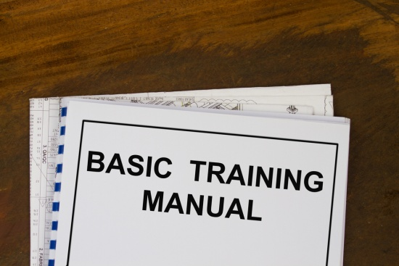
Ensure staff are trained
Types of computer system training
Participating in formal training which may be provided by the property or by the software supplier
Utilisation of dedicated training software
Reading the User’s manual
Observing and listening to an experienced operator
Asking questions
Writing your own notes
On-going coaching and mentoring
COMPLETE ACTIVITY 21
Notes:
Discussion & Complete Activity
What other types of training can be utilised?
Complete Activity 21

Slide 103

Monitor new systems
Importance of monitoring new computer systems
The accepted ways of monitoring the effectiveness of new computer systems will relate to determining:
Achievement of key performance indicators
The actual workplace effectiveness of the computer asset
The actual costs, savings or other benefits involved in using this asset
Notes:
Discussion
How can you monitor the success of new computer system assets?

Slide 104

Monitor new systems
Key performance indicators
Measuring the effectiveness of business computer systems can be broken down into many aspects depending on each manager and organisation, however can be broken down into the following categories:
Satisfaction
System usage
Performance/ usefulness
Productivity
Value analysis
Cost-benefit analysis
Notes:
Discussion
How can you monitor the success against these KPI’s?

Slide 105

Monitor new systems
Actual workplace effectiveness of computer asset
The activities associated with monitoring the actual workplace effectiveness of computer asset include:
Personal observation
Discussions with staff
Discussions with customers
Discussions with other stakeholders
Examination of the final products generated by the item
Notes:
Discussion
What information do you want to know from each of these methods?
What questions can you ask?

Slide 106

Monitor new systems
Actual workplace effectiveness of computer asset
Compliance reports
Use of checklists
Surveys
Checklists
Flowcharts
Benchmarking
Notes:
Discussion
What information do you want to know from each of these methods?

Slide 107

Monitor new systems
Actual costs, savings or other benefits
How has the company financial benefited by using the system
Identification of the number of reported breakdowns, down-time and lost production
Costs to service the item
Costs to repair and maintain the item
Running costs
Checking life cycle statistics for parts
Notes:
Discussion
How can you gather this information?

Slide 108

Monitor new systems
Ancillary considerations
Evaluation of the:
Promises made by a supplier that have been kept
Effectiveness and cost of maintenance plans and service contracts
Staff training
Warranties and guarantees
Workplace usage of the item
Physical workplace location of the item
COMPLETE ACTIVITY 22
Notes:
Discussion & Complete Activity
How can you gather this information?
Complete Activity 22

Slide 109
Element 3:
Maintain computer equipment and systems
Notes:
Introduce topic.
Class Activity – General Discussion
Ask general questions:
Why is it important to maintain computer assets?

Slide 110

Maintain computer equipment and systems
Performance Criteria for this Element are:
Establish and monitor systems for cleaning, minor maintenance and replacement of consumables in accordance with manufacturer’s instructions
Report faults to the nominated person or supplier for rectification
Establish and monitor procedures for ensuring security of data, including regular back-ups and virus checks
Notes:
Trainer identifies the Performance Criteria for this Element, as listed on the slide.

Slide 111

Maintain computer equipment and systems
Performance Criteria for this Element are:
Create document filing systems and procedures to reflect the size, nature and complexity of the workplace
Set up equipment to accept the software and functions being used
Notes:
Trainer identifies the Performance Criteria for this Element, as listed on the slide.

Slide 112

Maintain computer equipment
Importance of maintaining computer equipment and systems
Now that new business computer systems are operational, there must be some mechanisms in place to ensure that the system and its individual components are maintained to perform at the best of their ability.
What types of maintenance can be performed?
How can you do it?
How often should it be done?
Notes:
Discussion
Discuss the questions in the slide.

Slide 113

Maintain computer equipment
Types of maintenance
Preventative maintenance
Regular maintenance and servicing
Repairs
Physical cleaning of assets
Cleaning of systems and internal memory
Replacing consumables
Notes:
Discussion
What is the difference between these types of maintenance?

Slide 114

Preventive maintenance
Definition of preventative maintenance (PM)
Maintenance that is regularly performed on a piece of equipment to lessen the likelihood of it failing.
What are examples of PM?
What are the benefits of a PM program?
What are the tasks associated with establishing a PM program?
COMPLETE ACTIVITY 23
Notes:
Discussion & Complete Activity
Discuss the questions in the slide
Complete Activity 23

Slide 115

Maintenance
Scheduling of maintenance
Scheduling is the allocation of labour power, materials and equipment, at specific times and locations, for accomplishment of prescribed maintenance work.
What are considerations when scheduling maintenance?
Notes:
Discussion
Discuss the question in the slide

Slide 116
Maintenance
Considerations when scheduling maintenance
Labour available - in-house or contract
Materials and parts available
Special operation needs
Contingencies allowed for sudden emergency call-backs
Minimised impact on overall operability of the facility
Most efficient cost
Minimised customer awareness
Minimum downtime
Quick start-up and return to operability
Notes:
Discussion & Provide examples
Identify a number of common types of maintenance.
Explain how these considerations would impact on the maintenance.

Slide 117
Repairs
Repairs
The repair process returns a faulty computer system asset into an operational condition.
Something is broken on the asset and the repair process makes the machine functional again.
What are examples of repairs?
Who would perform these repairs?
Notes:
Discussion
Discuss the questions in the slide.

Slide 118
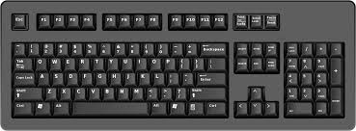
Physical cleaning of computer assets
Physical cleaning of computer assets
An important part of ensuring computer system assets are maintained, hygienic and retain a professional and functional look, is through regular cleaning.
What assets need to be cleaned?
How would you clean them?
When should they be cleaned?
Who should clean them?
COMPLETE ACTIVITY 24
Notes:
Discussion & Complete Activity
Discuss the questions in the slide
Complete Activity 24.

Slide 119
Cleaning of system
Cleaning of systems and internal memory
Besides conducting an actual clean, 'internal cleans' may include:
Creating more space on the hard disk
Reviewing programs
Deleting unwanted files
Cleaning dust from internal surfaces
Backing up files before major maintenance
Checking hard drive for errors
Decrementing the hard disk
Using up-to-date anti-virus programs
Notes:
Discussion
Why is this important?
What are the steps associated with each of these ‘internal cleans’?

Slide 120
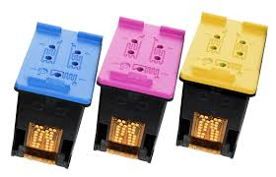
Replacing consumables
Replacing consumables
In order for a tourism organisation to be operating efficiently, it is essential that not only can staff operate the computer system assets that exists within the office environment, but to also be able to identify and replace used technology consumables.
What are examples of consumables?
Notes:
Discussion
Discuss question in the slide

Slide 121
Replacing consumables
Replacing consumables
When preparing systems for replacement of consumables the following needs to be considered:
Where are the consumables stored?
When should they be re-ordered?
What should be ordered?
What are common 'unit' sizes?
How much should be ordered?
Notes:
Discussion
Discuss questions in the slide

Slide 122
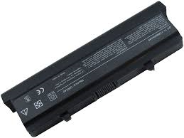
Replacing consumables
Replacing consumables
Use of manufacturer products?
Who should order?
From whom should they be ordered from?
Written record of consumables ordered?
Ordering process and authorisation?
Notes:
Discussion
Discuss questions in the slide

Slide 123
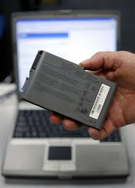
Replacing consumables
Training to replace consumables
As well as the physical process of replacing consumables, there may be operational considerations such as:
Unscrewing screws
Removing items
Turning off equipment
Performing back up of data
COMPLETE ACTIVITY 25
Notes:
Discussion & Complete Activity
What training may take place?
Complete Activity 25

Slide 124

Identify, report and resolve faults
Importance of identifying faults
Regardless of how much preventative maintenance you perform on your computer system assets, at times they will breakdown and faults will appear.
When faults appear, it is important to ensure that:
They are identified in a prompt manner
The correct procedures are in place to take the correct action to resolve the fault
Notes:
Discussion
What are common types of faults?

Slide 125
Identify, report and resolve faults
Examples of common faults
Computer is too slow
Internet downloads or uploads slow
Computer won't start up
Windows won't boot
Computer keeps restarting on its own
Monitor is blank
Abnormally functioning operating system or software
Notes:
Discussion
What are the solutions to these common types of faults?

Slide 126
Identify, report and resolve faults
Examples of common faults
Strange noises
Overheating
Pop-up ads keep appearing
READY light is not lit, or is glowing red
Self-test labels will not print
Labels will not feed, or feed continuously
Flat batteries, or batteries have been removed
Notes:
Discussion
What are the solutions to these common types of faults?

Slide 127
Identify, report and resolve faults
Examples of common faults
Electricity cord has been accidentally knocked out or the plug has been removed
Printer won't work
Poor print quality
Internet not connecting
Wi-Fi keeps disconnecting
Data or other connections have worked loose, or dropped out
Notes:
Discussion
What are the solutions to these common types of faults?

Slide 128
Identify, report and resolve faults
Examples of common faults
Can't open email attachments
Can't email other people
Programs aren't working on your PC
Power point is switched ‘on’ but the machine is turned ‘off’
Scanner not reading at all, reading partially, or reading incorrectly
Lack of signal from scanner to register /terminal – host stops responding
Toner or ink has run out
Notes:
Discussion
What are the solutions to these common types of faults?

Slide 129
Identify, report and resolve faults
Examples of common faults
Paper-rolls have run out, or paper has jammed
EFTPOS landline connection cannot be made to the bank, or connection is very slow
Equipment malfunction or breakdown
Power failure
Operator error has caused the system or equipment to freeze
Screen is frozen
COMPLETE ACTIVITY 26
Notes:
Discussion & Complete Activity
What are the solutions to these common types of faults?
Complete Activity 26

Slide 130

Identify, report and resolve faults
Identifying or anticipating faults
The preparation of a scheduled maintenance program
Routine checking of equipment
Reading the instruction booklets
Encouraging feedback from colleagues
Keeping a log book of detected faults
Performing regular OSH inspections
Notes:
Discussion
Why are these important?
What else can you do?

Slide 131

Identify, report and resolve faults
Actions to take when computer faults are identified
Note details of the fault
Notify the appropriate in-house IT expert
Check manual for trouble shooting hints
Utilise help desk, on-line help, etc
Call in IT support for a service call
Record notification of a service call
Equipment should be removed from service
Notes:
Discussion
Discuss the importance and tasks associated with these actions.

Slide 132

Identify, report and resolve faults
Actions to take when computer faults are identified
Equipment should be labelled clearly as ‘Out of Service
Equipment should be stored in the appropriate out of service area
Appropriate report fault paperwork should be completed and submitted
Returning the item to the supplier or forwarding it to an accredited repairer.
In extreme cases, a new item may have to be purchased
Monitor repairs made
Notes:
Discussion
Discuss the importance and tasks associated with these actions.

Slide 133

Identify, report and resolve faults
Note details of a fault
Person's name
Contact details
Email address
Sequence of events
Asset name
Model
Notes:
Discussion
Why are these pieces of information important when recording details of a fault?

Slide 134

Identify, report and resolve faults
Note details of a fault
Finance officer
Problem description
Service contract number
Serial number of machine
Urgency of the problem
Access hours
Notes:
Discussion
Why are these pieces of information important when recording details of a fault?

Slide 135
Using external specialists
Using external specialist to conduct maintenance and servicing
Specialised assistance may include:
External Information Technology (IT) support
Use of commercial ‘help’ desks
Manufacturer
Notes:
Discussion
What are examples of these specialists in your region?
What services do they provide?

Slide 136

Using external specialists
Service details to be recorded
Outside contractors should also leave a written/ or printed report detailing the following:
Work that they have done
Time they have taken
Parts that they have replaced
Faults they have identified
Warrantees relating to repairs
COMPLETE ACTIVITY 27
Notes:
Discussion & Complete Activity
Why is this important?
Complete Activity 27

Slide 137
Secure and back up data
Importance of securing and backing up data
In many cases, whilst the breakdown of hardware is a nuisance, the loss of data may be detrimental to an organisation.
There are a number of other tasks that can be performed that will minimise the effect and loss of information due to computer system breakages or by theft of data.
What tasks can be performed?
Notes:
Discussion
Discuss the question in the slide.

Slide 138
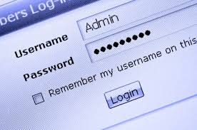
Passwords
Establishing passwords
In order to protect the integrity of the system from unauthorised access and also to maintain the confidentiality of establishment information and customer details, it is usual for passwords to be used.
What is involved in establishing passwords?
What policies and procedures may apply to establishing and using passwords?
How can you make passwords as secure as possible
Notes:
Discussion
Discuss the questions in the slide.

Slide 139

Prevent computer viruses
Computer viruses
Computer viruses are identified as small software programs that have been designed to spread from one computer to another and to negatively interfere with the operations of a computer.
How do they get into your computer?
What damage can they do?
How can you prevent or remove viruses?
Notes:
Discussion
Discuss the questions in the slide.

Slide 140

Prevent computer viruses
Damage caused by computer viruses
There are endless computer viruses that exist, each with a detrimental purpose including:
Corrupt or delete data on your computer
Use your email program to spread itself to other computers
Erase all information on hard disks
Notes:
Discussion
Discuss impact of this damage.
Provide personal stories of trainer and participants

Slide 141

Prevent computer viruses
The spread of computer viruses
One way to control viruses is to identify how viruses can be spread.
The way computer viruses can spread includes:
Through internet downloads
As attachments in email messages or instant messaging messages
Disguised as attachments of audio and video files and images
Notes:
Discussion
Provide personal stories of trainer and participants

Slide 142

Prevent computer viruses
Control of computer viruses
The main aim of controlling viruses is to:
Remove it
Prevent further infection
Notes:
Discussion
Describe approaches that can be undertaken for each method

Slide 143
Prevent computer viruses
Types of virus preventative actions
Examples of virus preventative actions include, but certainly not limited to:
Install antivirus tools
Keep computer current with latest updates
Run regular virus checks
Run regular scandisk facility
COMPLETE ACTIVITY 28
Notes:
Discussion & Complete Activity
What are examples of each?
Complete Activity 28

Slide 144

Use computers safely
Use computer systems in a safe and secure manner
Use the technology in the correct manner
Use the technology effectively
Maintain security
Staff should not use equipment for private use
Do not use private discs or flash drives in workplace computers
Never allow customers or others to access or use establishment equipment
Report any instances of breaches of protocols
Notes:
Discussion
What are examples of each?
What else can you do to use computer systems in a safe and secure manner?

Slide 145
Back up data
Perform regular backups of data
Despite our best efforts, despite all our preventative maintenance, and despite all the feedback in the world from staff, technology will still let us down.
One good way of minimising the adverse impacts of the computer crashing is to do regular backups of data.
A back-up is a second copy made to protect your information against accidental loss or damage.
What types of back-ups can be performed?
Notes:
Discussion
Discuss question in the slide

Slide 146
Back up data
Golden rules to backing up data
A simple way to minimise the loss of information is to have three versions:
Original
Back up of the original
Back up of the back up
In addition it is vital to have back up versions stored in different secure locations
Notes:
Discussion
Discuss steps taken to back up personal data at home and relate how it can be used in the workplace.

Slide 147

Back up data
Methods to back up data
Online storage services - such as iDrive, iCloud, Dropbox, Carbonite, Google Drive, Mozy or SkyDrive
Consolidate data on different PC's and phones to one centralised point
External hard drives
Using backup software - such as Windows Backup
COMPLETE ACTIVITY 29
Notes:
Discussion & Research & Complete Activity
Discuss benefits of each method
Conduct research and identify types of online storage systems
Complete Activity 29

Slide 148

Computer filing systems
Types of data management policies and procedures
Administration requirements
Internal accounting systems
Authorised use of equipment
Security
Confidentiality
Timing and frequency requirements
Notes:
Discussion
What are examples?
What other data management policies and procedures may you use?

Slide 149

Computer filing systems
Storing data
Storage in directories and sub-directories
Storage on hard drives
Storage on networked computers
Appropriate filing and storage of hard copies of computer-generated documents
Notes:
Discussion
What are other ways to store data?

Slide 150

Computer filing systems
Key outcomes of a data management system
All data will be managed in accordance with set organisational procedures
All staff understand what constitutes official data
Business activities are to be documented in the form of records
Any data or record can be retrieved easily when requested
All data must be stored safely and securely
Archived data will be managed in accordance with legislative requirements
Intellectual Property is captured, maintained and protected
COMPLETE ACTIVITY 30
Notes:
Discussion & Complete Activity
What other key outcomes would you have?
How can you achieve these key outcomes?
Complete Activity 30

